Slide 1
Carrier Aggregation in the MAC Layer for 5G Group 3 Specification 38.321 Mentored by:- Abhijeet sir
Enhancing Throughput and Latency through Multi-Carrier Management.

Slide 2
Presented by
Bhakti S
Ranjita Karadad
Ritesh Mishra
Vaidehi Shailendra Bhosale
Vanaja Dukka
Vivek Kumar
Yash Pramod Gulhane
Yengala Dharmendra Kumar Reddy

Slide 3
Contents
Introduction
Objectives
Principles of Carrier Aggregation in 5G
Implementation of the Carrier Aggregation
Impact of Carrier Aggregation on 5G Networks
Challenges and Considerations
Conclusion
Code

Slide 4
Introduction
Carrier Aggregation (CA) in the MAC (Medium Access Control) layer refers to the process of combining multiple carrier frequencies at the MAC layer to increase data throughput and network efficiency.
By performing Carrier Aggregation in the MAC layer, 5G network can:-
-Increase data throughput.
-Improve network capacity.
-Enhance user experience.
The MAC layer plays a crucial role in managing CA, ensuring efficient resource allocation, data scheduling, and transmission across multiple carriers.
Carrier Aggregation in the MAC layer:-
Carrier Selection: The MAC layer selects the carriers to be aggregated based on factors like channel conditions, traffic load, and user requirements.

Slide 5
Resource Allocation: The MAC layer allocates resources (such as bandwidth, power, and time slots) across the aggregated carriers.
Data Scheduling: The MAC layer schedules data transmission across the aggregated carriers, ensuring efficient use of resources.
Data Transmission: Data is transmitted simultaneously across the aggregated carriers, increasing overall throughput.
Harq Management: The MAC layer manages Hybrid Automatic Repeat Request (HARQ) processes across the aggregated carriers, ensuring reliable data transmission.
Importance in 5G:-
1. Increase Data Rates:-
-Enhanced Throughput: Carrier aggregation significantly boosts data rates by combining multiple carriers, providing higher speeds and better user experience.
-Faster Downloads and Uploads: Users benefit from quicker access to data-intensive applications and services.
2. Improved Network Capacity:-
-Accommodating More Users: By increasing the available bandwidth, CA allows the network to handle a greater number of simultaneous users without degradation in performance.-
-Enhanced Network Performance: Better management of network resources leads to improved overall network performance, including reduced congestion and latency.

Slide 6
Objectives
Increased Data Throughput: Combine multiple carriers to achieve higher data rates and increase overall throughput.
Improved Network Capacity: Accommodate more users and devices by aggregating multiple carriers, enhancing network capacity.
Enhanced Spectral Efficiency: Optimize resource utilization by aggregating carriers, leading to improved spectral efficiency.
Better Resource Utilization: Dynamically allocate resources across aggregated carriers to ensure efficient use of available bandwidth.
Improved User Experience: Provide faster data rates, lower latency, and better overall performance, leading to an enhanced user experience.

Slide 7
Increased Flexibility: Support various carrier combinations and configurations, enabling flexible network deployment and optimization.
Reduced Latency: Minimize latency by transmitting data simultaneously across multiple carriers.
Improved Reliability: Ensure reliable data transmission through HARQ management and link adaptation across aggregated carriers.

Slide 8
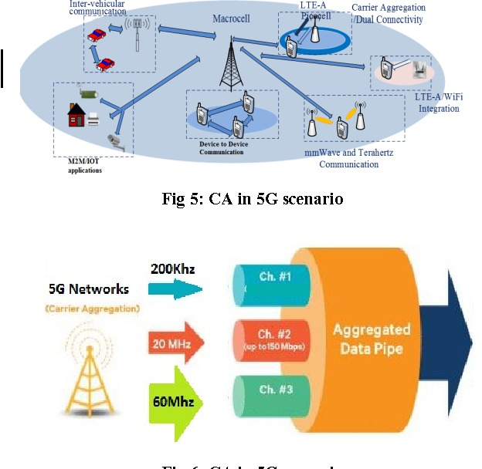
Diagram

Slide 9
Principles of Carrier Aggregation in 5G
How Carrier Aggregation Works:
*Carrier Bandwidth Aggregation:
-Combining Frequencies: Aggregates multiple carrier frequencies to form a larger bandwidth pool, enhancing overall data capacity and throughput.
-Larger Bandwidth Pool: Utilizes various frequency bands to increase the effective bandwidth available for data transmission, leading to higher data rates.
*Resource Allocation:
-Efficient Management: Allocates resources dynamically across aggregated carriers to optimize network performance and balance load.
-Performance Optimization: Ensures efficient use of available bandwidth and prevents congestion by adjusting resource distribution based on traffic conditions.

Slide 10
Application in the MAC Layer:
*Multi-Carrier Scheduling:-
-Scheduling Algorithms: Implements algorithms to manage and schedule resource allocation across different carriers, optimizing performance and minimizing interference.
-Resource Scheduling: Prioritizes and assigns resources to different users and applications based on their requirements and network conditions.
*Data Transmission:
-Simulated Transmission: Simulates how data is transmitted across multiple aggregated carriers to assess and enhance throughput and reduce latency.
Enhanced Throughput: Evaluates the impact of carrier aggregation on data transfer speeds and latency, aiming to improve overall user experience.
Key Benefits:-
-Increased data throughput
-Improved network capacity
- Enhanced spectral efficiency
- Better resource utilization
- Improved user experience

Slide 11
Implementation of the Carrier Aggregation
Carrier Selection: Select multiple carriers based on traffic demands, channel conditions, and carrier availability.
Resource Allocation: Allocate resources to each carrier using a suitable resource allocation algorithm (e.g., Round-Robin, Proportional Fairness, or Maximum Throughput).
Data Scheduling: Schedule data transmission across aggregated carriers, considering factors like channel conditions, interference, and transmission errors.
Data Transmission: Transmit data across aggregated carriers, using techniques like OFDM, SC-FDMA, or MU-MIMO.
Performance Monitoring: Monitor and calculate performance metrics like throughput, latency, spectral efficiency, and resource utilization.

Slide 12
Impact of Carrier Aggregation on 5G Networks
Faster Speeds: This results in higher overall data rates, leading to faster download and upload speeds for users.
Enhanced Data Rates:
*Higher Throughput:-
-Increased Bandwidth: Carrier aggregation combines multiple frequency bands, significantly increasing the total bandwidth available for data transmission.
-Faster Speeds:-This result in higher overall data rates, leading to fast download and upload speeds for users.
*Improved User Experience:
- Seamless Connectivity: Users experience smoother and more reliable connections, enhancing their overall experience with data-intensive applications such as video streaming and online gaming.

Slide 13
Improve Latency:
*Reduce Delay:-
-Efficient Resource Allocation: Carrier aggregation allows for better management and distribution of network resources, reducing the time it takes for data to travel between devices and network infrastructure.
-Optimized Scheduling: Enhanced scheduling algorithms minimize delays in data transmission, leading to lower latency.
*Real-Time Performance:-
- Improved Responsiveness: Applications requiring real-time interaction, such as voice over IP (VoIP) and online gaming, benefit from reduced latency, resulting in more responsive and fluid experiences.
Network Efficiency:-
*Better Spectrum Utilization:-
-Optimized Use of Frequency Bands: Carrier aggregation maximizes the use of available spectrum by combining multiple frequency bands, reducing wasted bandwidth and improving overall network efficiency.
-Enhanced Capacity- Increase the network’s capacity to handle more users and data traffic simultaneously.

Slide 14
*Increased Network Capacity:
-Scalability: Carrier aggregation allows networks to scale more effectively by adding more carriers to handle increasing traffic demands, ensuring consistent performance even as user numbers grow.
* By leveraging carrier aggregation, 5G networks can deliver faster data rates, lower latency, and improved network efficiency, ultimately providing a better user experience and supporting a wide range of applications and services.

Slide 15
Challenges and Considerations
Challenges in Implementation:
*Complex Resource Management:-
-Efficient Scheduling: Managing and scheduling resources across multiple carriers requires sophisticated algorithms to ensure optimal performance without causing congestion or inefficiency.
-Dynamic Allocation: The need to adapt resource allocation in real-time based on varying traffic conditions and user demands adds to the complexity.
*Interference Management:-
-Carrier Interference: Aggregating multiple carriers can lead to potential interference between them, especially when using adjacent frequency bands.

Slide 16
Mitigation Strategies: Developing effective strategies to mitigate interference is crucial to maintaining signal quality and network performance.
Considerations for Future Works:-
1. Advanced Scheduling Algorithms:
Optimized Resource Allocation: Future work could focus on creating more sophisticated algorithms that better handle the complexities of multi-carrier environments, improving efficiency and performance.
AI and Machine Learning: Leveraging AI and machine learning techniques to predict traffic patterns and optimize resource allocation dynamically.
2. Integration with Other Technologies:- Combining carrier aggregation with other 5G technologies, such as:
- Massive MIMO (Multiple-Input Multiple-Output):-Combining carrier aggregation with Massive MIMO (Multiple-Input Multiple-Output) can further enhance network capacity and coverage by using multiple antennas for data transmission.
- Beamforming:-Integrating beamforming techniques with carrier aggregation can improve signal focus and reduce interference, leading to better overall network performance.

Slide 17
- Network Slicing:-Incorporating carrier aggregation into network slicing frameworks for more flexible and efficient 5G service delivery tailored to different use cases.
- Edge Computing
3. Scalability and Flexibility: Ensuring carrier aggregation solutions are scalable and flexible to accommodate diverse network architectures and user demands.
4. Standardization and Interoperability: Addressing standardization and interoperability challenges to facilitate seamless deployment and operation.
*By acknowledging and addressing these challenges and considerations, researchers and industry experts can work towards developing more efficient, scalable, and robust carrier aggregation solutions for 5G networks.

Slide 18
Conclusion
Summary of key Points:-
*Importance of Carrier Aggregation:-
-Enhanced Data Rates: Carrier aggregation plays a vital role in significantly increasing data throughput, allowing for faster speeds and better user experiences in 5G networks.
-Improved Network Capacity: By combining multiple carriers, network capacity is greatly expanded, enabling more efficient handling of increasing traffic demands and more users.
-Carrier aggregation offers significant gains in throughput, latency, and resource utilization.
Final Thought:-
*Critical Component of 5G Optimization:
-Key to Future Networks: Carrier aggregation is essential for optimizing 5G networks, ensuring that they can meet the ever-growing demands for faster, more reliable connectivity.

Slide 19
-Foundation for Advanced Features: As 5G continues to evolve, carrier aggregation will serve as a foundation for integrating other advanced technologies, future enhancing network capabilities.
*Continued Research and Development:
-Addressing Challenges: Ongoing research is needed to overcome the challenges of implementing carrier aggregation, such as interference management and complex resource allocation.
-Enhancing Performance: Continued innovation will drive further enhancements in carrier aggregation, ensuring that 5G networks can continue to deliver top-tier performance in the face of increasing demands and new use cases.
*Carrier aggregation is a vital technology for unlocking the full potential of 5G networks. By addressing the challenges and considerations outlined in this presentation, we can ensure the widespread adoption and optimization of carrier aggregation, ultimately leading to improved network performance and user experience.

Slide 20
Code(MAC layer- Carrier Aggregation )

Slide 21
Thank You

